Slide 1

Introduction to
PHASER
Rufo n. gabrillo jr.

Slide 2
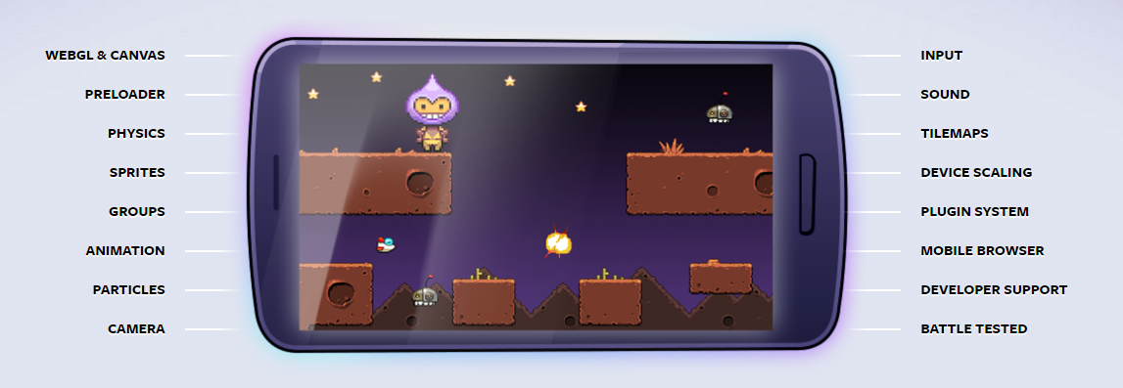
What is PHASER?
Phaser is an open source project and available to download for free. There are no fees to pay when using Phaser, regardless if you use it for a commercial or free project.
Phaser features:

Slide 3
Installing a web server
On Windows there are lots of "bundle installers" available which package together and set-up popular web technologies like Apache, PHP and MySQL from a single exe.
We need to set up a webserver to run our game but no worries when you decided to package the app. It will run as normal game as expected.

Slide 4
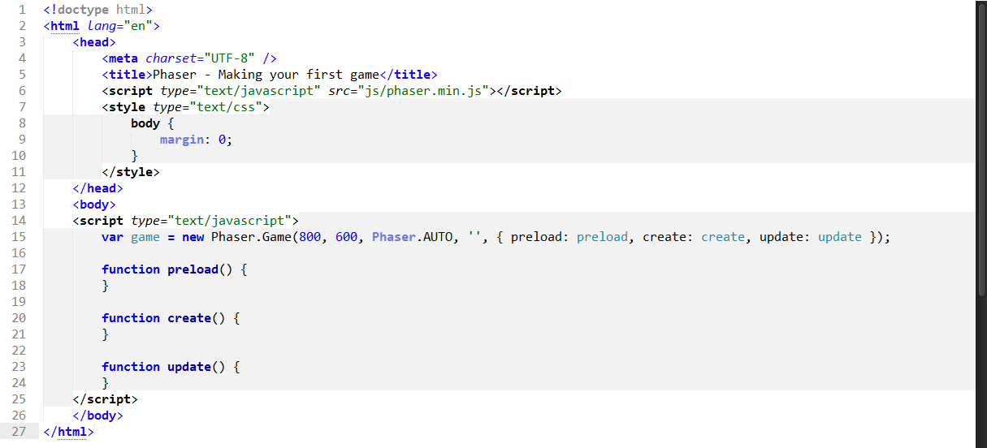
Creating the Game

Slide 5
Line 1 is where you bring Phaser to life by creating an instance of a Phaser.Game object and assigning it to a local variable called 'game'. Calling it 'game' is a common practice, but not a requirement, and this is what you will find in the Phaser examples.
The first two parameters are the width and the height of the canvas element that Phaser will create. In this case 800 x 600 pixels. Your game world can be any size you like, but this is the resolution the game will display in. The third parameter can be either Phaser.CANVAS, Phaser.WEBGL, or Phaser.AUTO. This is the rendering context that you want to use. The recommended parameter is Phaser.AUTO which automatically tries to use WebGL, but if the browser or device doesn't support it it'll fall back to Canvas.

Slide 6
The first two parameters are the width and the height of the canvas element that Phaser will create. In this case 800 x 600 pixels. Your game world can be any size you like, but this is the resolution the game will display in. The third parameter can be either Phaser.CANVAS, Phaser.WEBGL, or Phaser.AUTO. This is the rendering context that you want to use. The recommended parameter is Phaser.AUTO which automatically tries to use WebGL, but if the browser or device doesn't support it it'll fall back to Canvas.
The fourth parameter is an empty string, this is the id of the DOM element in which you would like to insert the canvas element that Phaser creates. As we've left it blank it will simply be appended to the body. The final parameter is an object containing four references to Phasers essential functions. Their use will be thoroughly explained later. Note that this object isn't required - Phaser supports a full State system allowing you to break your code into much cleaner single objects. But for a simple Getting Started guide such as this we'll use this approach as it allows for faster prototyping.

